Slide 1
Energy Efficiency Escalator
GROUP MEMBERS ID
190105045
190105046
190105047
190105048
190105050
180105108
Course Name: Micro-processor Unit Lab
Course No : EEE- 3210

Slide 2
INITIATION
Escalator is a power-driven, continuous moving stairway designed transporting passengers up and down short vertical distances in huge building or in a shopping mall from one floor to another.
Escalators are used around the world moving pedestrian traffic in places where elevators are unserviceable.
It’s also a high energy motor.

Slide 3
OBJECTIVE
Unfortunately, escalator is power consuming for a time being as it runs all over the day even it is carrying people or not . So our main objective is to make energy efficient escalator.
REASON OF CHOOSING THIS PROJECT
Our aim of this project is to reduce power consumption by developing a sensor based escalator which will save energy by activating itself when it will sense people coming towards it.
Our project will minimize excess energy loss & instruct the escalator only to run when it is needed.

Slide 4
WORKING PRICIPLE
When someone comes in front of the escalator the PIR motion sensor detects motion and gets HIGH . It sends signal to Arduino’s digital pin number 9 .
Then the gear motor assigned with the escalator starts rotating for 5 seconds. We can also increase the rotating time in the code and the motor will run for more times.
LCD is also used in our project . When DC motor start running, lcd shows "Start" and when motor stop it shows "Stop". In the mean time while its running , if someone comes in front of the escalator , it will continue rotating for another 5 seconds.
While no motion is detected , the escalator remain stationary and it does not run.

Slide 5
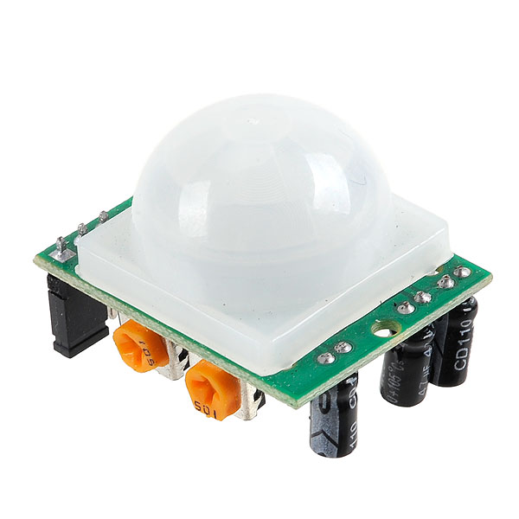
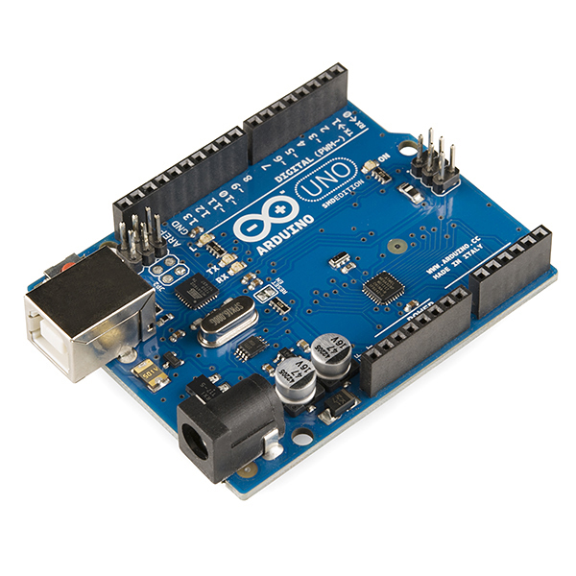
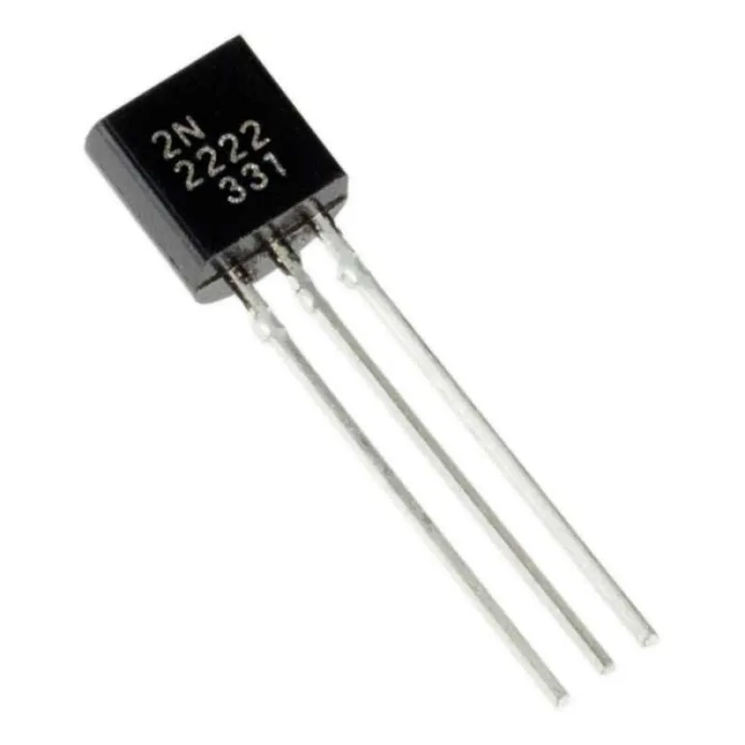
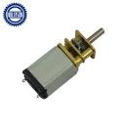
COMPONENTS
Elements that we used for our project are:
Arduino Uno R3
PIR Motion Sensor
6 volt DC Gear Motor
2N2222A Transistor
Breadboard
Jumper Wires
9 volt Battery for Arduino
6 volt Battery for Motor
LCD

Slide 6
PIR MOTION SENSOR
PIR motion is the major component of energy efficiency escalator.
Passive infrared (PIR) sensors use a pair of pyroelectric sensors to detect heat energy in the surrounding environment.
When someone comes in front of escalator the PIR motion sensor detects motion & gets high. It sends Arduino’s digital pin number 9.
Two sensors sit beside each other in the motion , when the signal differential occur between them the motion sensor starts to work.

Slide 7
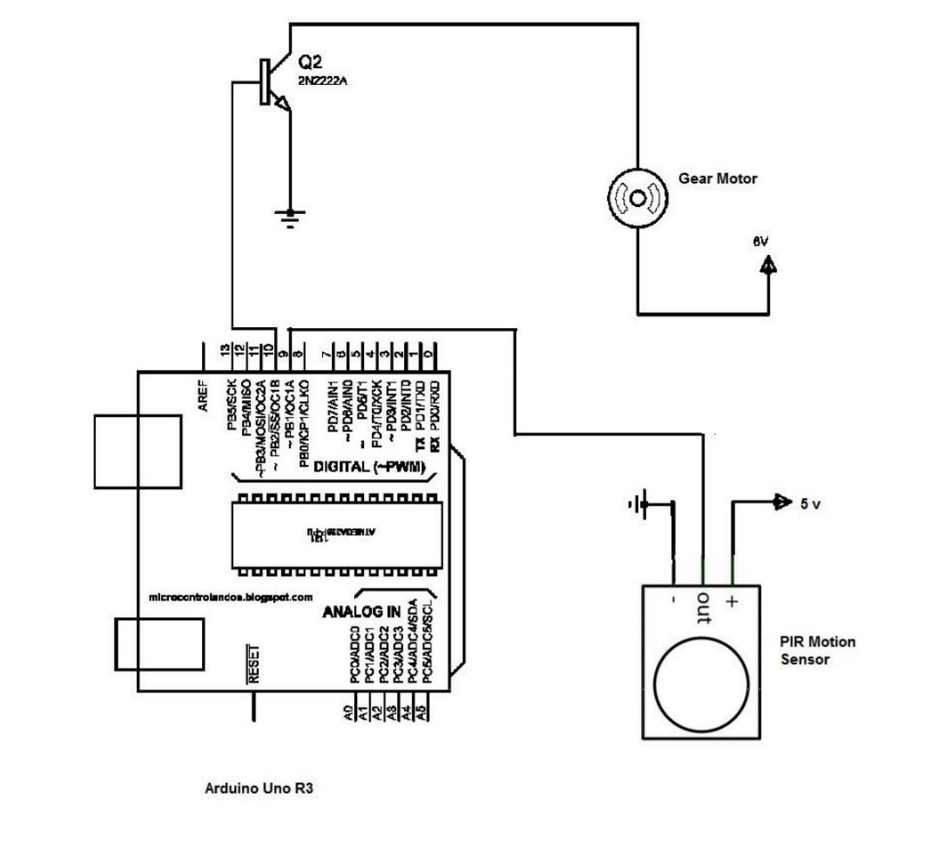
CIRCUIT DIAGRAM

Slide 8
CODE TO DRIVE THE PROJECT
#include<LiquidCrystal_I2C.h>
LiquidCrystal_I2C lcd(0x27,16,2);
int pirPin = 9;
int motorPin = 10;
void setup ()
{
Serial.begin(9600);
lcd.init();
lcd.backlight();
pinMode(pirPin,INPUT);
pinMode(motorPin,OUTPUT);
}
void loop()
{
if(digitalRead(pirPin)==HIGH)
{
lcd.setCursor(2,0);
lcd.print("Escalator Starts.");
delay(1000);
digitalWrite(motorPin,HIGH);
delay (3000);
}
else
{
lcd.setCursor(8,0);
lcd.print("STOP");
delay(100);
lcd.clear();
digitalWrite(motorPin,LOW);
}
delay(200);
lcd.clear();
}

Slide 9
OPPORTUNITIES, APPLICATIONS
In this modern day still most of the shopping malls use the old fashioned escalator which runs all through the day without stopping. This is a huge loss of electricity in a developing country like us. So to make energy efficient escalator we can use this device with a relay switch to work with the real life escalator. This will save a great amount of electric energy.

Slide 10
FURTHER IMPROVEMENTS
In future we can add a laser triggered circuit with this one to measure the height so that the escalator runs when only people step in to the escalator; not any animals or anything rather than human.

Slide 11
THANK YOU FOR LISTENING OUR PESENTATION

